Slide 1

ROAD TRAFFIC ACCIDENT HOTSPOT DETECTION AND SAFETY ANALYSIS IN NIGERIA
A CAPSTONE PROJECT REPORT
BY
GROUP 21, DATA ANALYTICS TRACK, TECHCRUSH
JUNE, 2025.

Slide 2
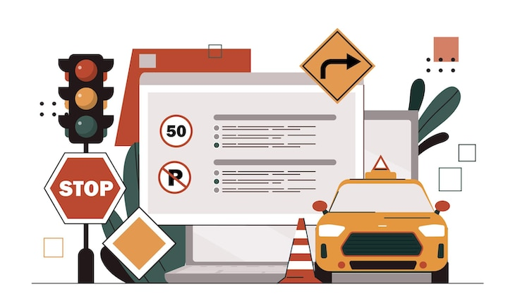
EXECUTIVE SUMMARY
This project analyzes road traffic accidents across Nigeria using real data from the Federal Road Safety Corps (FRSC).
It uncovers accident-prone states, severity trends, and common causes.
Through SQL-based analysis and Power BI visualizations, this project delivers key insights and proposes data-driven safety recommendations to reduce accidents and save lives.

Slide 3
ACKNOWLEDGEMENT
We express gratitude to God for His grace and to our mentors, Ms. Mary Oladokun, Ms. Grace Emeruwa, and Mr. Olaniyi Eluwole. Special thanks to the FRSC for providing public datasets. Appreciation goes to all team members who contributed through data cleaning, SQL querying, dashboard creation, and reporting.

Slide 4
PROJECT OBJECTIVES
Analyze accident frequency and severity by state.
Identify trends based on accident severity levels.
Determine the most common causes of road accidents.
Visualize casualties and people involved using dashboards.
Recommend actionable safety interventions.

Slide 5


DATA OVERVIEW
Datasets Used:
Road Accident Severity Data (Q1 2023 – Q3 2024).
Road Accident Causative Factors Data (Q1 2023 – Q3 2024).
Source: Federal Road Safety Corps (via NBS Public Dataset).
Key Features: State, Quarter, Year, Severity levels, Casualties, and Causes.

Slide 6



TOOLS USED
Microsoft Excel – Data cleaning and structuring.
SQL Server – Data aggregation, joins, and transformation.
Power BI – Visualization, interactive dashboards, and maps.

Slide 7
ANALYSIS PROCESS
Cleaned and merged datasets using STATEID.
Performed SQL queries to calculate totals, ranks, and trends.
Created views for causes, casualties, and severity.
Built dashboards using Power BI.
Generated actionable insights and recommendations.

Slide 8
KEY FINDINGS
FCT recorded the highest number of accidents in both 2023 and 2024.
Serious accidents made up over 50% of total cases.
Speed violation caused 40–45% of total accidents.
Q2 consistently recorded the highest accident frequency.
Ogun, Kaduna, Nasarawa and Oyo are also among the top accident-prone states.

Slide 9
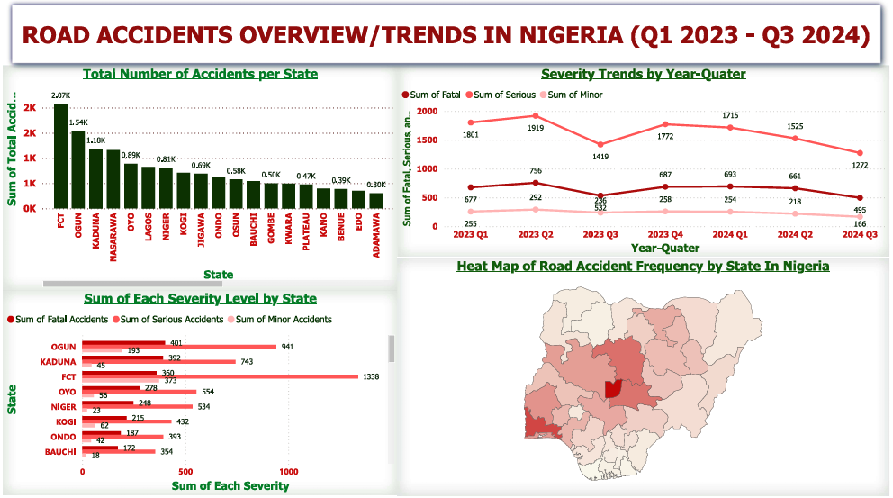
DASHBOARD 1 – ROAD ACCIDENTS OVERVIEW
Visuals:
Bar Chart: Total accidents per state
Line Chart: Severity trends by year-quarter
Clustered Bar: Fatal, Serious, Minor per state
Nigeria Map: Total accidents per state (based on color saturation)
Insight: This dashboard highlights the accident distribution across states and shows how severity levels have changed over time.

Slide 10
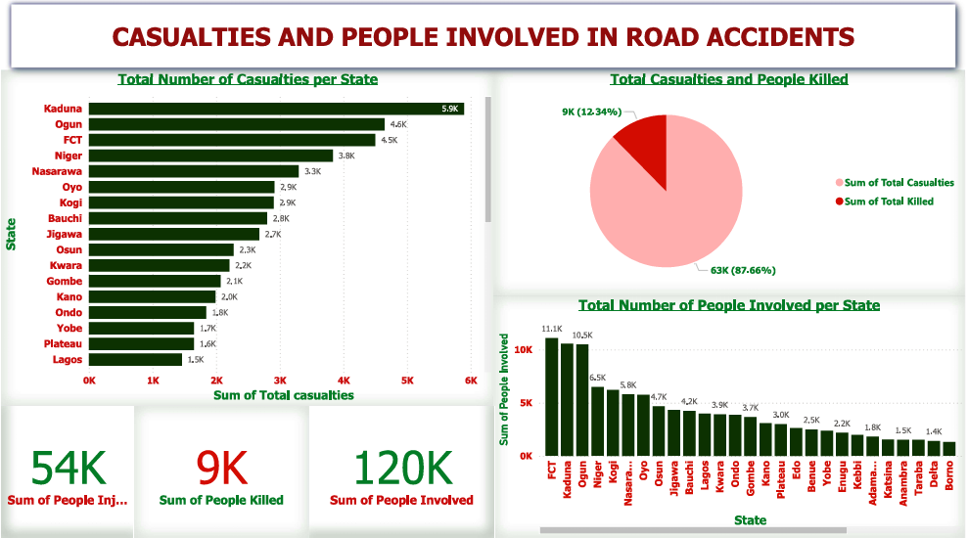
DASHBOARD 2 – CASUALTIES & PEOPLE INVOLVED
Visuals:
Bar Chart: Casualties by state
Pie Chart: Total Casualties vs People killed
Card visuals: National totals (Injured, Killed, Involved)
Bar chart: Total people involved per state
Insight: Reveals which states had the highest number of injuries and deaths, and provides an overview of total people affected.

Slide 11
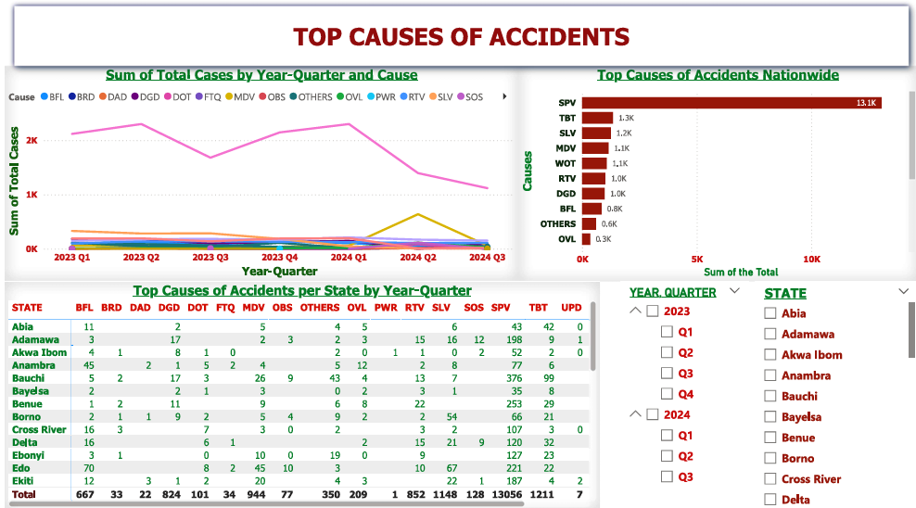
DASHBOARD 3 – TOP CAUSES OF ACCIDENTS
Visuals:
Line Chart: Top causes by quarter
Bar Chart: National cause frequency
Matrix: Top 5 causes per state and quarter
Slicers: For Year, Quarter, State
Insight: Speed Violation leads as the top cause nationwide. Matrix view helps track how leading causes differ per state and time.

Slide 12
REFERENCE TABLE FOR ROAD ACCIDENT CAUSES
ACRONYM | FULL MEANING
SPV | Speed Violation
UPD | Use of Phone while Driving
TBT | Tyre Burst
MDV | Mechanically Deficient Vehicle
BFL | Brake Failure
OVL | Overloading
DOT | Dangerous Overtaking
WOT | Wrongful Overtaking
DGD | Dangerous Driving
BRD | Bad Road
RTV | Route Violation
OBS | Road Obstruction Violation
SOS | Sleeping on Steering
DAD | Drinking Under Alcohol/Drug Influence
PWR | Poor Weather
FTQ | Fatigue
SLV | Sign Light Violation
OTH | Others

Slide 13
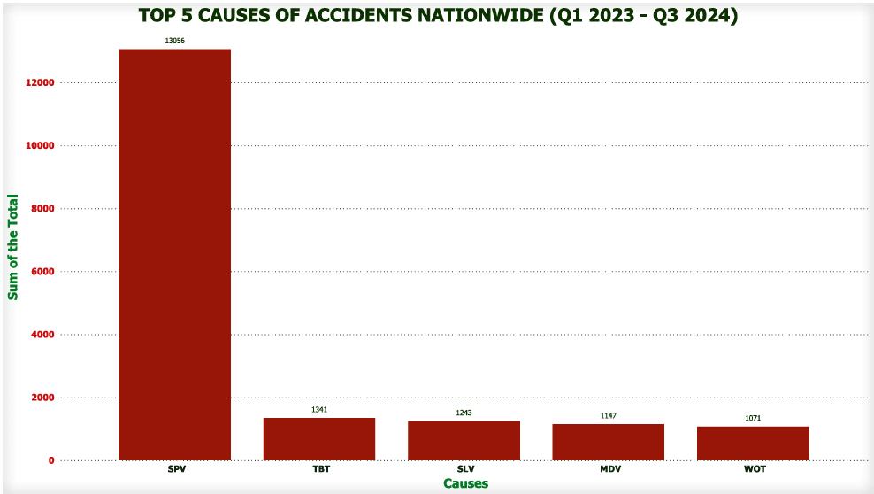

Slide 14
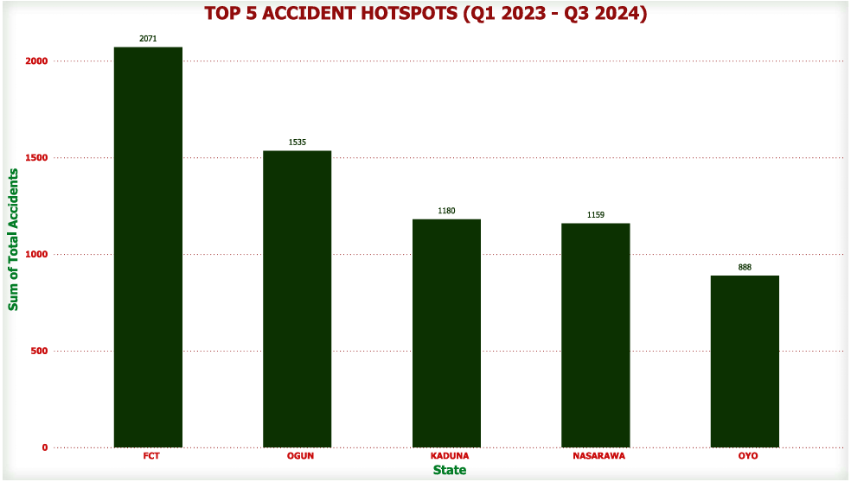

Slide 15
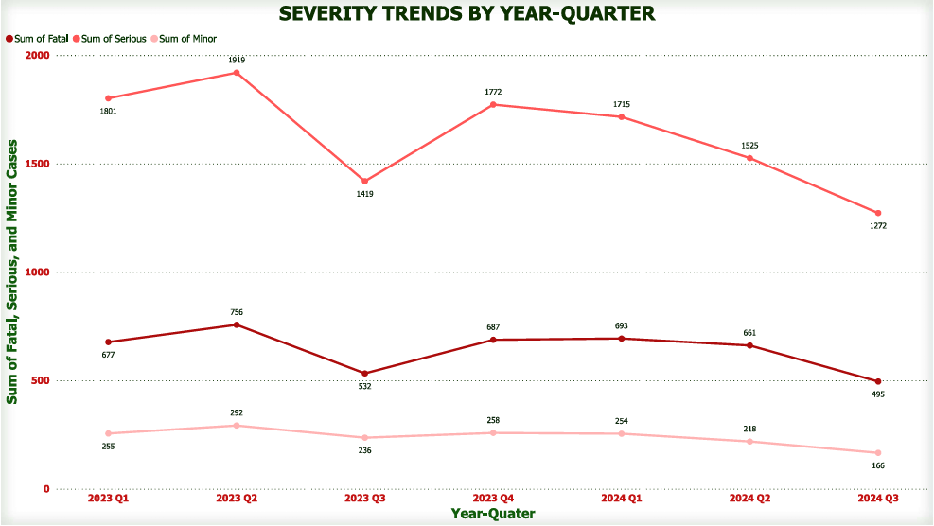

Slide 16
RECOMMENDATIONS
Install speed cameras in top 5 accident states.
Improve emergency services in high-fatality regions.
Rehabilitate roads in areas with frequent BRD and MDV cases.
Launch awareness campaigns during Q2 and Q4.
Promote real-time accident reporting systems.

Slide 17
CONCLUSION
This project demonstrates the value of data in addressing road safety. By identifying accident hotspots, top causes, and trends, stakeholders can take evidence-based actions to reduce road accidents and fatalities across Nigeria.

Slide 18
THANK YOU

